Slide 1
Members of Parliament
Key Stage 3

Slide 2

Who is a Member of Parliament or MP?
A Member of Parliament (MP) is an individual who has been elected by the people to represent a specific geographic area, known as a Constituency in the parliament.

Slide 3

Who can become an MP?
01
02
03
a Citizen of the Maldives
not a Citizen of a foreign country
a Muslim and a follower of Sunni school of Islam
04
has attained the age of Eighteen years
05
is of sound mind
Notes:
The conditions required to become an MP are the following:
is a citizen of the Maldives
is not a citizen of a foreign country
is a Muslim and a follower of a Sunni school of Islam
has attained the age of eighteen years
is of sound mind.
A person who has obtained Maldivian citizenship and has Maldivian residence is qualified to be a member of People’s Majlis five years after obtaining citizenship.

Slide 4
Who cannot become an MP?
Someone who has a decreed debt which is not being paid as provided in the judgement;
Someone who has been convicted of a criminal offence and is serving a sentence of more than twelve months
Someone who has been convicted of a criminal offence and sentenced to a term of more than twelve months, unless a period of three years has elapsed since his release, or pardon for the offence for which he was sentenced
is a member of the Judiciary.
Notes:
Someone who has a decreed debt which is not being paid as provided in the judgement;
Someone who has been convicted of a criminal offence and is serving a sentence of more than twelve months
Someone who has has been convicted of a criminal offence and sentenced to a term of more than twelve months, unless a period of three years has elapsed since his release, or pardon for the offence for which he was sentenced
is a member of the Judiciary.

Slide 5

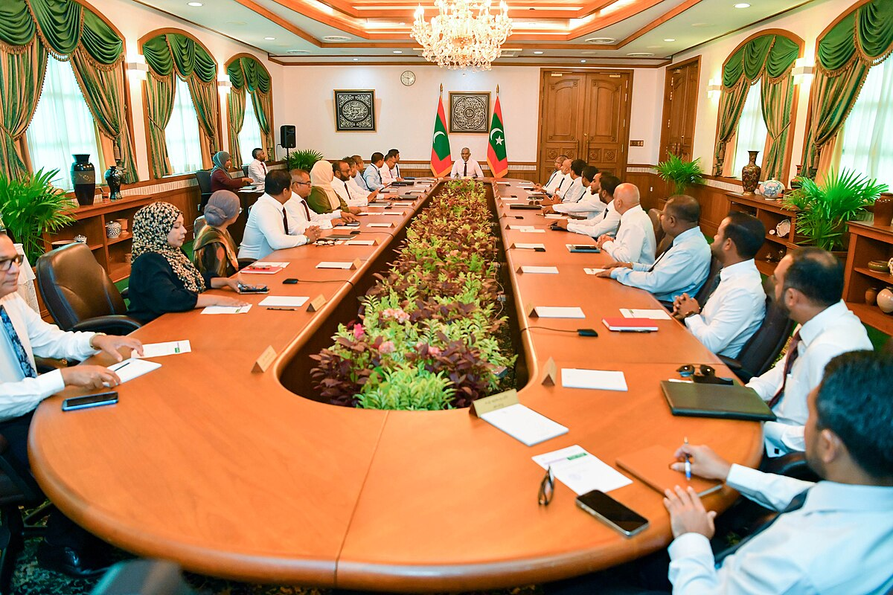
What roles or positions are prohibited for an MP while serving in the Majlis?
1. the Cabinet of Ministers;
2. the office of State Minister, Deputy Minister, or other State office of an equivalent level;
3. an Independent Commission or an Independent Office;
4. the Civil Service;

Slide 6
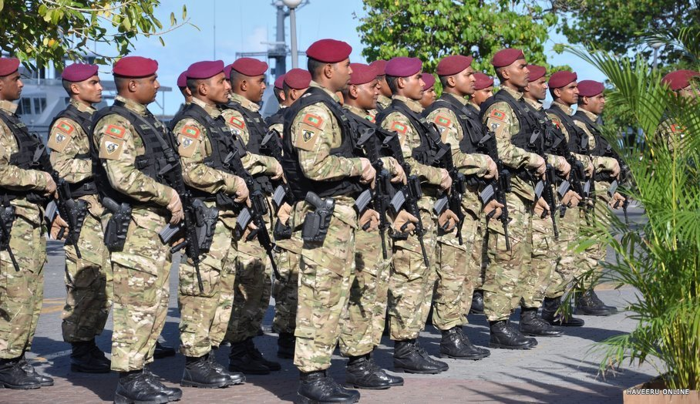
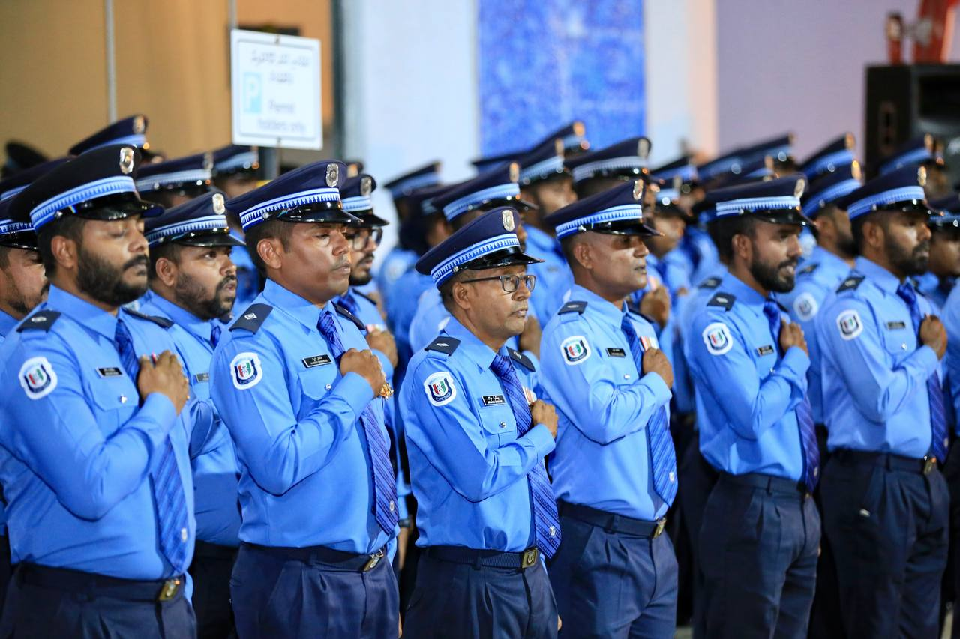
What roles or positions are prohibited for an MP while serving in the Majlis?
5. a corporation wholly or partly owned or managed by the Government;
6. the Armed Forces;
7. the Police;
8. any other office of the State except an office held by virtue of being a member of the People’s Majlis.

Slide 7

How is the number of MPs determined?
number of constituencies
population of each administrative division
Notes:
Electoral Divisions:
Constituencies determined by Elections Commission based on the population of the administrative divisions.
2 MPs are elected for the 1st 5000 residents in each administrative division.
1 additional member per 5000 residents in excess of rhe 1st 5000.

Slide 8
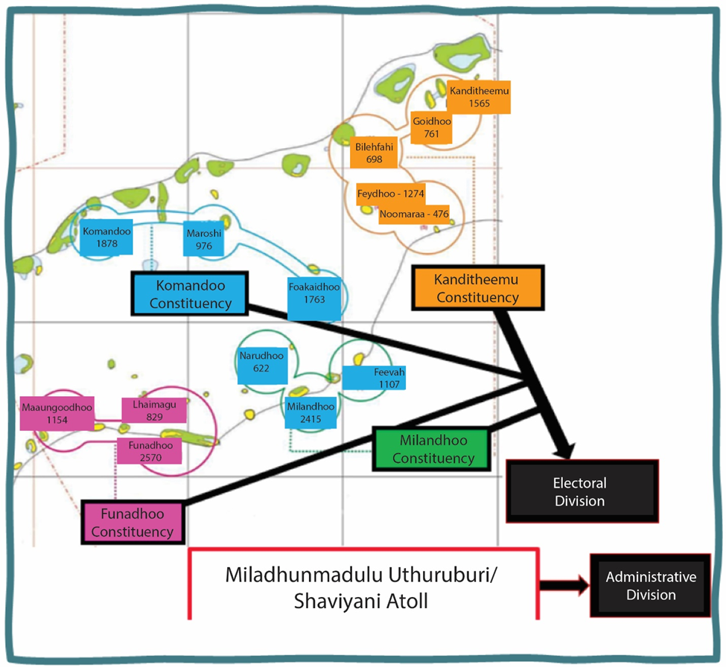
How is the number of MPs determined?
Narudhoo
622
Feevah
1107
Milandhoo
2415
Notes:
Electoral Divisions:
Constituencies determined by Elections Commission based on the population of the administrative divisions.
2 MPs are elected for the 1st 5000 residents in each administrative division.
1 additional member per 5000 residents in excess of rhe 1st 5000.

Slide 9
Role of MPs:
discussing
creating
passing
legislation
Notes:
The main function of People’s Majlis is creating, discussing, and passing legislation.
Any member of the Cabinet or the Government may be required by the People's Majlis to appear in person for its proceedings, answer to questions honestly under oath, and provide any documentation the People's Majlis requests regarding the proper fulfillment of the member's duties and obligations.
Members have the authority to summon and question any person or institution.
The members also have the authority, by a resolution to remove the President or Vice president from office with due process in making.

Slide 10
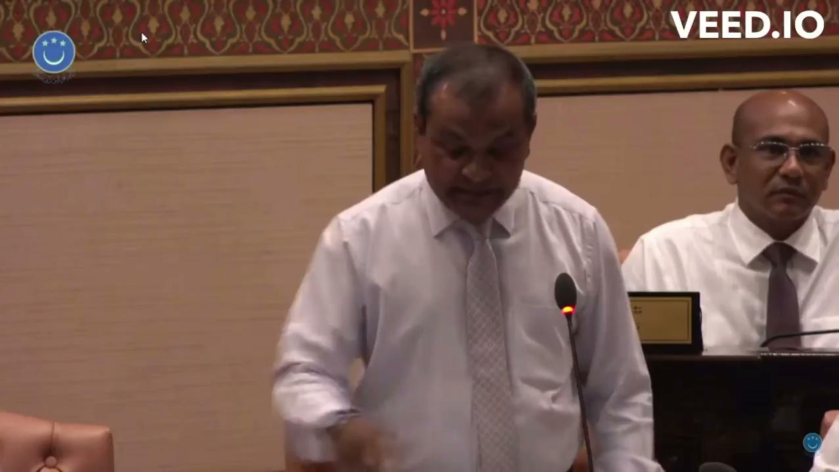
Video credit: People’s Majlis, Raajje TV

Slide 11

Privilege of members
No member or other person shall be subject to any proceedings in any court, nor shall any person be subject to any inquiry, arrest, detention, or prosecution, provided that the same is not in violation of tenet of Islam, in relation to anything said in, produced before, or submitted to the People's Majlis or any of its committees, or in relation to any vote cast

Slide 12

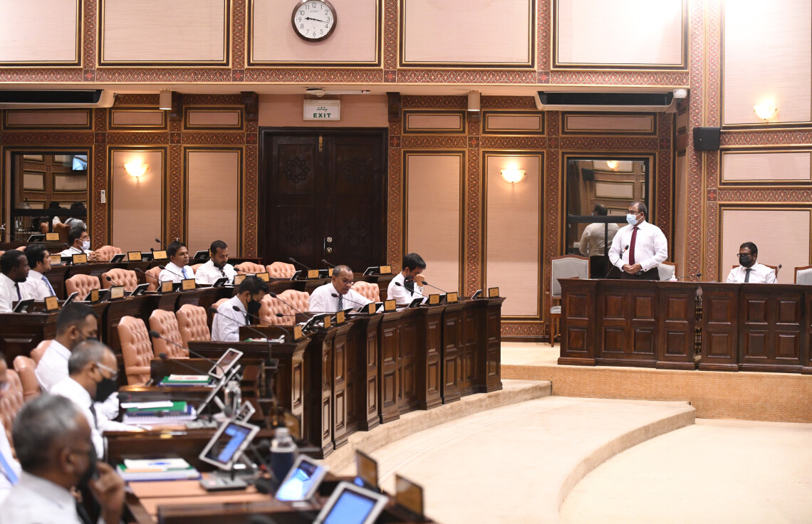
Activity:
Role play of a Majlis Sitting to question a Minister (e.g. Minister of Education)
Notes:
Activity (24 minutes)
Role play of a Majlis Session to question a Minister (e.g. Minister of Education)
Arrange the classroom to depict the chamber of Majlis.
Ask one student to become the Speaker of Majlis and another student to act as the Secretary General
Ask 2 to 3 students to act as the minister and other officials from the ministry.
All remaining students act as members of parliament from different constituencies
Assume that the questions have been sent to the minister with 14 day notice accordingly by the Speaker.
Sample questions
What are the consequences of changing the beginning of the academic year?
How many multipurpose halls are being built throughout the nation?
Which islands are given priority in building multipurpose halls, and on what basis are the islands selected?
Are there any plans from the ministry to upgrade school libraries and laboratories? If so, what are the plans, and how long would it take to do so?
Questioning process
Speaker introduces the session and asks specific Majlis members to proceed with the questions.
Members have to address the other party with proper respect, like honorable minister, and ministers would also have to address members as honorable members.
After the question has been posed, the Speaker then gives the minister the chance to answer the question.
Minister may take about 2 minutes to answer the main question and 1 minute to answer the related sub question
After all the questions have been answered by the minister, Speaker then thanks the minister and opens the floor to other members to ask any questions.
After this, Speaker again thanks the minister and the members and announces the end of the questioning session.
When asking questions, members should refrain from asking hypothetical questions, confidential questions, or questions for which the information has already been published in the public domain.

